Slide 1

离散数学
Discrete Mathematics
钟芳明
离散数学
Discrete Mathematics

Slide 2
Review
Ordered pair
Cartesian product
Definition of relation and binary relation
Cartesian Product-set (subset)
Properties of relation
reflexive, antireflexive, symmetric, antisymmetric, transitive
Relation equality

Slide 3
Chapter 4 Binary Relation
4.4 Properties of relations

Slide 4
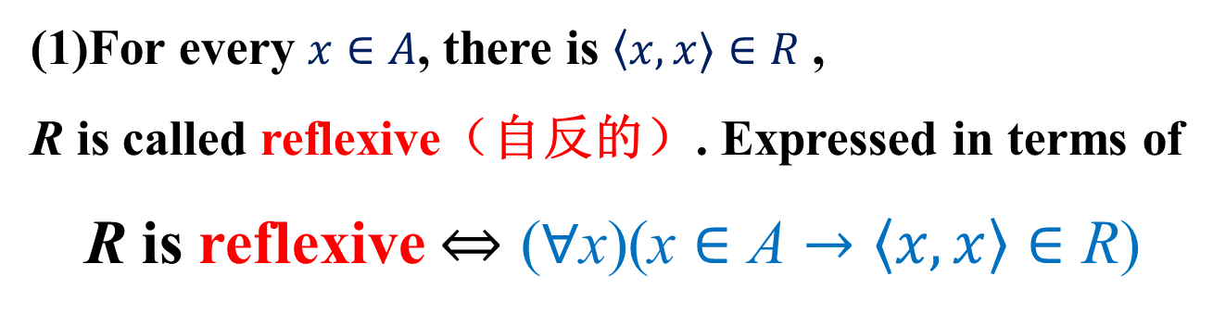
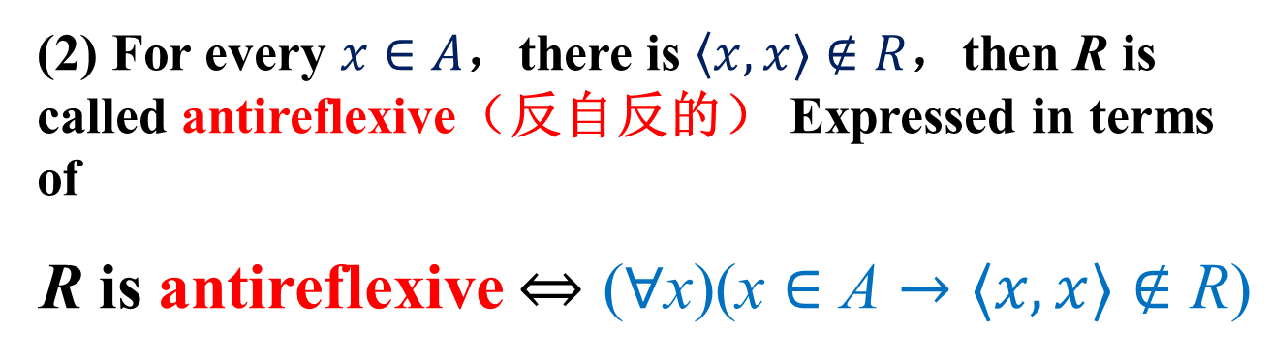
Properties of relation 关系的性质
关系的性质
关系的表示
关系图
关系矩阵
关系的运算
合成
幂
逆
闭包
Definition: let R be a binary relation on A
(1)For every $x∈A$, there is $〈x,x〉∈R$ ,
R is called reflexive（自反的）. Expressed in terms of
R is reflexive $⇔\text{(}∀\text{x}\text{)(}\text{x}∈\text{A}→〈x,x〉∈\text{R}\text{)}$
(2) For every $x∈A$，there is $〈x,x〉∉R$，then R is called antireflexive（反自反的） Expressed in terms of
R is antireflexive $⇔\text{(}∀\text{x}\text{)(}\text{x}∈\text{A}→〈x,x〉∉\text{R}\text{)}$

Slide 5
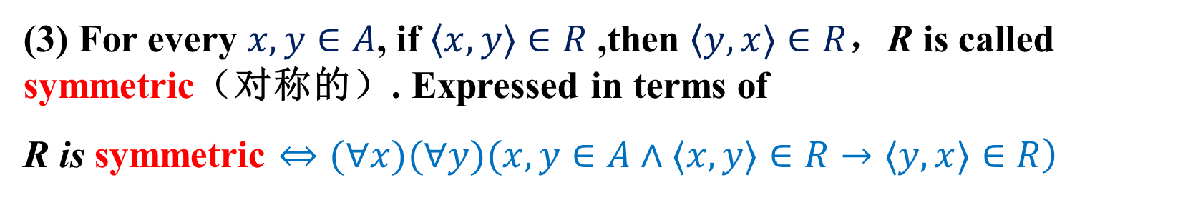
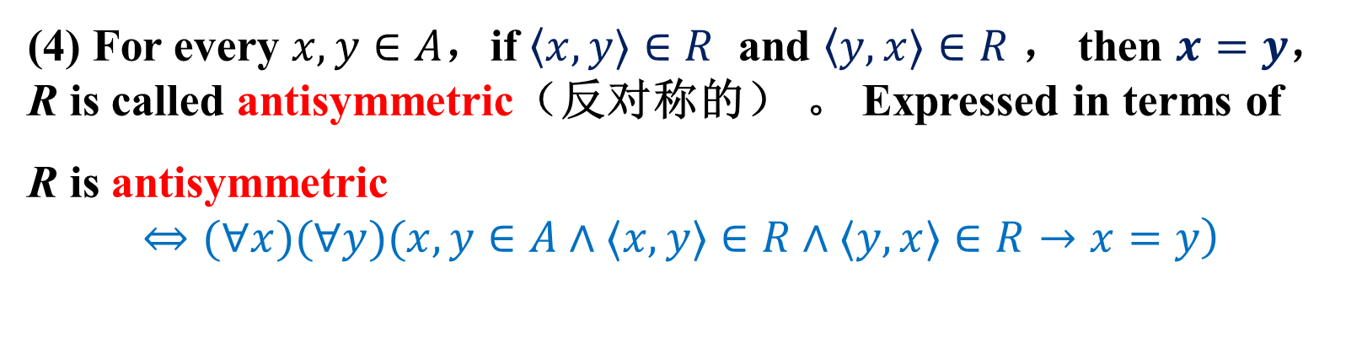
Properties of relation
关系的性质
关系的表示
关系图
关系矩阵
关系的运算
合成
幂
逆
闭包
(3) For every $x,y∈A$, if $〈x,y〉∈R$ ,then $〈y,x〉∈R$，R is called symmetric（对称的）. Expressed in terms of
R is symmetric $\left.⇔(∀x)(∀y)(x,y∈A∧〈x,y〉∈R→〈y,x〉∈R\right)$
(4) For every $x,y∈A$，if $〈x,y〉∈R$ and $〈y,x〉∈R$ ， then $x=y$， R is called antisymmetric（反对称的） 。 Expressed in terms of
R is antisymmetric
$$\left.⇔(∀x)(∀y)(x,y∈A∧〈x,y〉∈R∧〈y,x〉∈R→x=y\right)$$

Slide 6
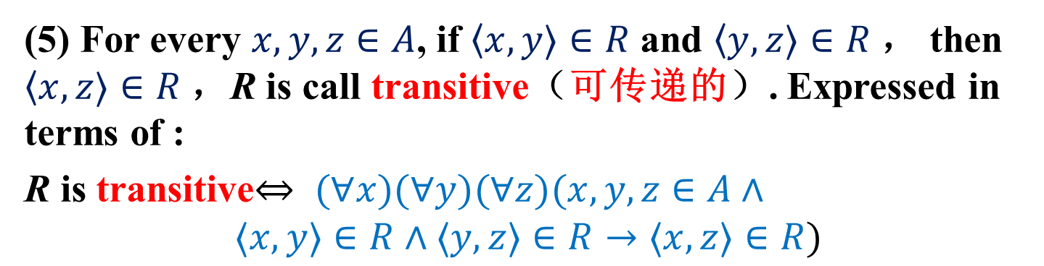
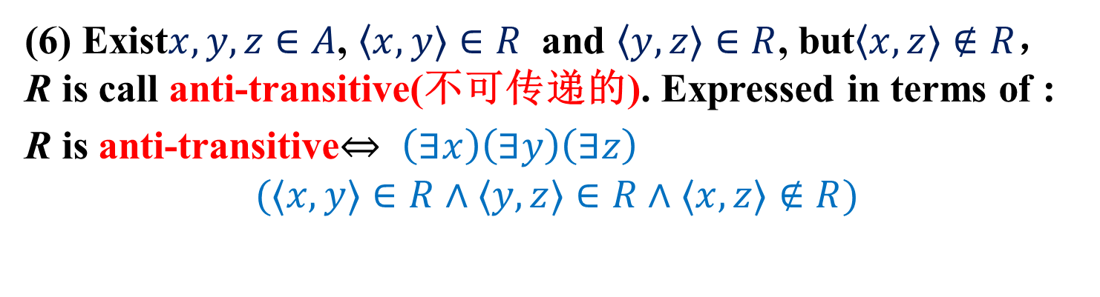
Properties of relation
关系的性质
关系的表示
关系图
关系矩阵
关系的运算
合成
幂
逆
闭包
(5) For every $x,y,z∈A$, if $〈x,y〉∈R$ and $〈y,z〉∈R$， then $〈x,z〉∈R$，R is call transitive（可传递的）. Expressed in terms of :
R is transitive$⇔ (∀x)(∀y)(∀z)(x,y,z∈A∧$
$$〈x,y〉∈R∧〈y,z〉∈R→〈x,z〉∈R)$$
(6) Exist$x,y,z∈A$, $〈x,y〉∈R$ and $〈y,z〉∈R$, but$〈x,z〉∉R$， R is call anti-transitive(不可传递的). Expressed in terms of :
R is anti-transitive$⇔ \left(∃x\right)\left(∃y\right)\left(∃z\right)$
$$(〈x,y〉∈R∧〈y,z〉∈R∧〈x,z〉∉R)$$

Slide 7
Chapter 4 Binary Relation
4.5 Representation of relation

Slide 8
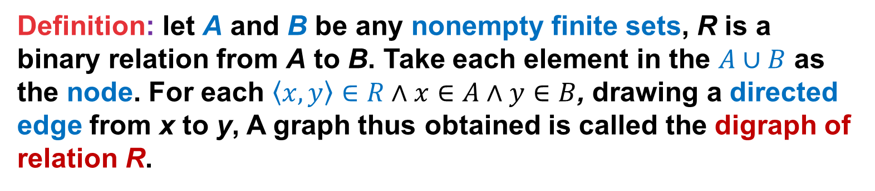
4.3 Representation of relation
关系的性质
关系的表示
关系图
关系矩阵
关系的运算
合成
幂
逆
闭包
The digraph of a relation (关系图)
Definition: let A and B be any nonempty finite sets, R is a binary relation from A to B. Take each element in the $A∪B$ as the node. For each $\left\langle x,y\right\rangle ∈R∧x∈A∧y∈B$, drawing a directed edge from x to y, A graph thus obtained is called the digraph of relation R.
A
B
1
3
Example：A={1,2,4}; B={3,5,6};
Relation R={<1,3>,<2,6>,<2,5>}
2
5
4
6

Slide 9
The digraph of a relation
关系的性质
关系的表示
关系图
关系矩阵
关系的运算
合成
幂
逆
闭包
Example：let A={2,3,4,5,6}, B={6,7,8,12}. The binary relation R from A to B is
Draw the digraph of R。
solution： First find out R
3
12
7
4
6
5
2
8

Slide 10
The digraph of a relation
关系的性质
关系的表示
关系图
关系矩阵
关系的运算
合成
幂
逆
闭包
The digraph shows the properties of relation
symmetric relation
antisymmetric
relation

Slide 11
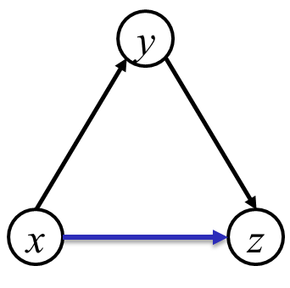
Properties determined by digraph
关系的性质
关系的表示
关系图
关系矩阵
关系的运算
合成
幂
逆
闭包
R是自反的：关系图中每个结点都有自圈
R是反自反的：关系图中每个结点都无自圈
R是对称的：关系图任意两个结点间若存在有向边，那么必有双向的有向边
R是反对称的：关系图中任意两个结点间必无双向边
R是可传递的：关系图中任意的x和y、y和z之间存在有向边，则x和z之间也存在有向边
R是不可传递的：关系图中存在x和y、y和z之间存在有向边，则x和z之间没有有向边

Slide 12
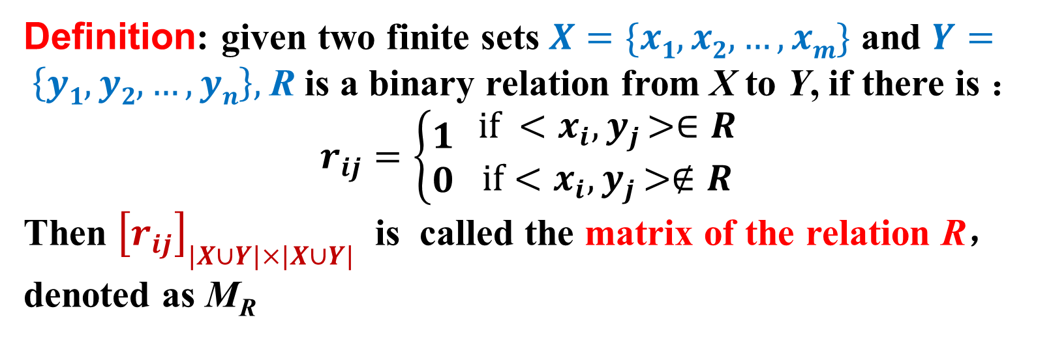
The matrix of a relation (关系矩阵)
关系的性质
关系的表示
关系图
关系矩阵
关系的运算
合成
幂
逆
闭包
Definition: given two finite sets $X=\{x1,x2,…,xm\}$ and $Y= \left\{y1,y2,…,yn\right\},$R is a binary relation from X to Y, if there is ：
$$r_{ij}=\left\{\begin{matrix}1 \\ 0\end{matrix}\right.\begin{matrix} if <x_{i}{,y}_{j}>∈R \\ if<x_{i}{,y}_{j}>∉R\end{matrix}$$
Then ${\left[r_{ij}\right]}_{|X∪Y|×|X∪Y|}$ is called the matrix of the relation R，denoted as M_{R}
Example：Let A={1,2,3,4}, R is the binary relation defined on A，R={<2,1>,<3,1>,<3,2>,<4,1>}. Write the matrix of the relation。

Slide 13
The matrix of a relation
关系的性质
关系的表示
关系图
关系矩阵
关系的运算
合成
幂
逆
闭包
Example：let A={1,2,3},B={a,b,c}, R is a binary relation from A to B, and R={<1,a>,<2,b>,<3,c>} ， Try to draw the digraph and matrix of R.

Slide 14
The matrix of a relation
关系的性质
关系的表示
关系图
关系矩阵
关系的运算
合成
幂
逆
闭包
The matrix of R is M and the element in M is m_{ij}
If R is a reflexive relation, all the elements on the main diagonal of M are equal to 1
If R is a antireflexive relation, all the elements on the main diagonal of M are equal to 0
R is a symmetric relation, if and only if m_{ij}= 1 whenever m_{ji}= 1
R is a antisymmetric relation, if and only if m_{ij} = 0 or m_{ji} = 0 when i≠j
R is transitive, m_{ik}=1 whenever m_{ij}=1 and m_{jk}=1；
R is not transitive, if there exists i,j,k, m_{ij}=1 and m_{jk}=1，m_{ik} ≠ 1 ；

Slide 15
Chapter 4 Binary Relation
4.6 Relation operations

Slide 16
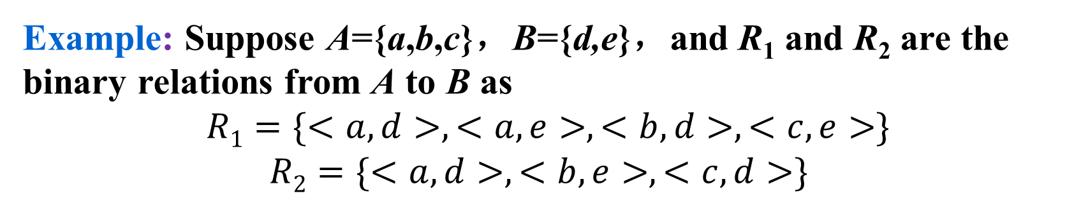
Relation operations 关系的运算
关系的性质
关系的表示
关系图
关系矩阵
关系的运算
合成
幂
逆
闭包
Because relation is special set, the operations of set are also available to relation.
Example: Suppose A={a,b,c}，B={d,e}，and R₁ and R₂ are the binary relations from A to B as
$R1=\{<a,d>,<a,e>,<b,d>,<c,e>\}$
$$R2=\{<a,d>,<b,e>,<c,d>\}$$

Slide 17
Relation operation
关系的性质
关系的表示
关系图
关系矩阵
关系的运算
合成
幂
逆
闭包
Composite (合成)
Suppose R is a relation from X to Y and S is a relation from Y to Z，then the composite of R with S is a relation from X to Z, where if <x,y>∈R and <y,z>∈S then <x,z>∈R◦S.
Example： Suppose X={1,2,3,4}，Y={2,3,4} and Z={1,2,3}. R is the relation from X to Y, and S is the relation from Y to Z as：
Compute the composite of R with S, and outline the matrices and digraph of R◦S.

Slide 18
Relation operation
关系的性质
关系的表示
关系图
关系矩阵
关系的运算
合成
幂
逆
闭包
Solution：

Slide 19
Relation operation
关系的性质
关系的表示
关系图
关系矩阵
关系的运算
合成
幂
逆
闭包
Defining Boolean operations：
Boolean Product:
0+0=0，1+0=0+1=1+1=1
1·1=1， 0·1= 1·0= 0·0=0
Replace the + with disjunction, and * with conjunction.

Slide 20
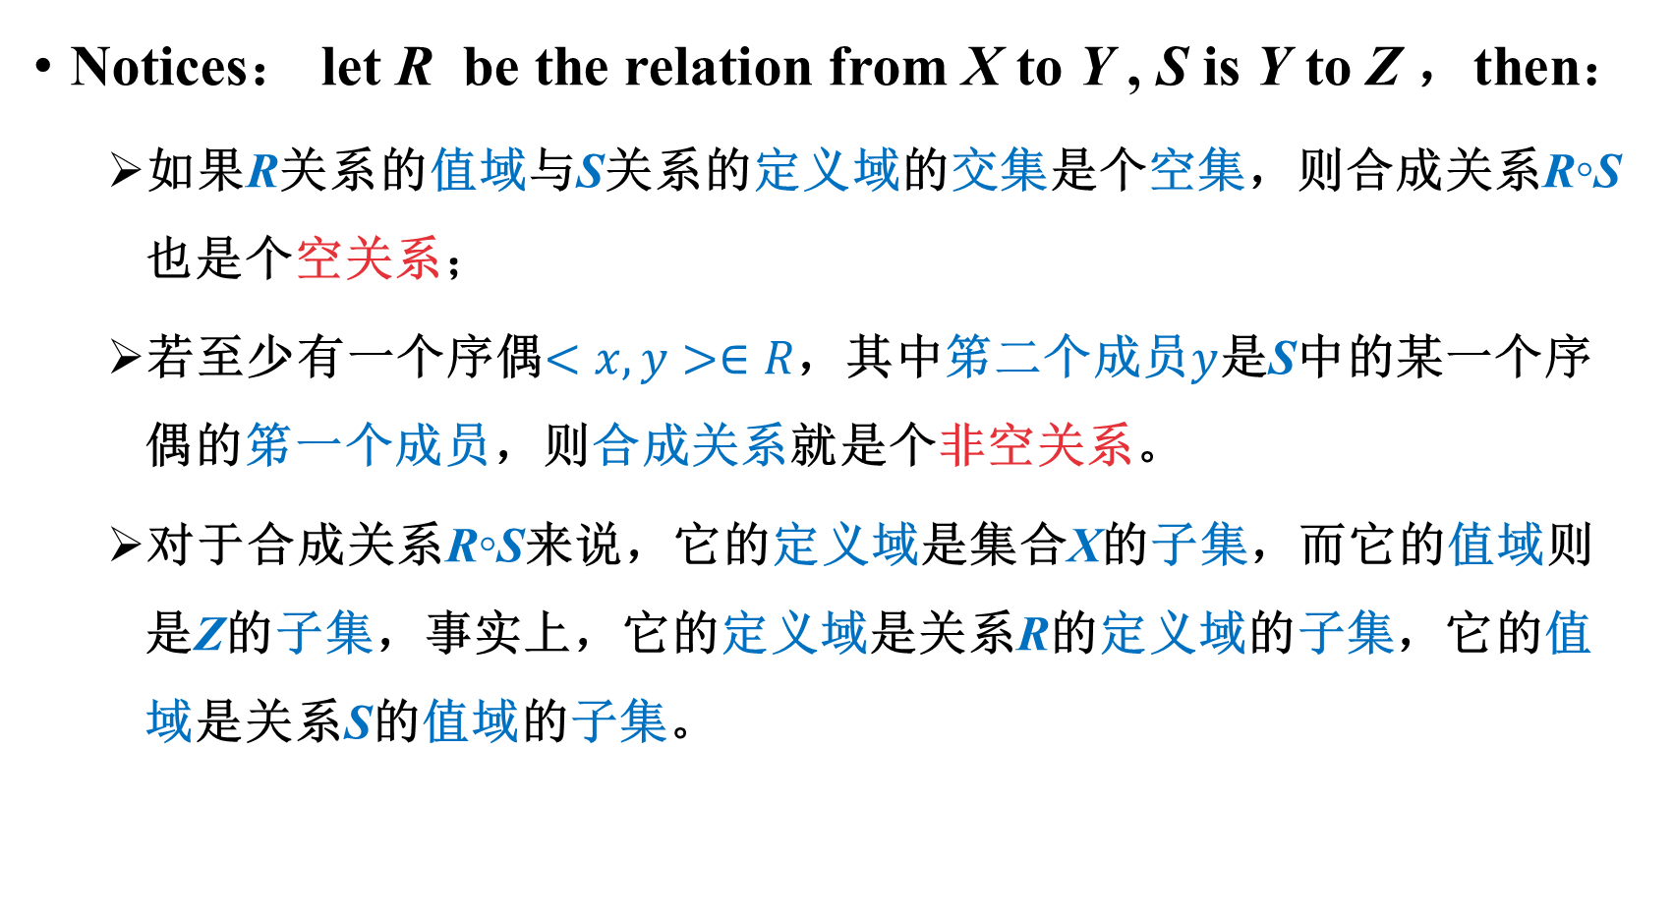
Relation operation
关系的性质
关系的表示
关系图
关系矩阵
关系的运算
合成
幂
逆
闭包
Composite (合成)
Notices： let R be the relation from X to Y , S is Y to Z ，then：
如果R关系的值域与S关系的定义域的交集是个空集，则合成关系R◦S也是个空关系；
若至少有一个序偶$<x,y>∈R$，其中笫二个成员$y$是S中的某一个序偶的笫一个成员，则合成关系就是个非空关系。
对于合成关系R◦S来说，它的定义域是集合X的子集，而它的值域则是Z的子集，事实上，它的定义域是关系R的定义域的子集，它的值域是关系S的值域的子集。

Slide 21
Relation operation
关系的性质
关系的表示
关系图
关系矩阵
关系的运算
合成
幂
逆
闭包
Theorem: given the sets X, Y, Z and W, let R1 be the relation from X to Y, R2 and R3 is Y to Z, R4 is a relation from Z to W, so there are:

Slide 22
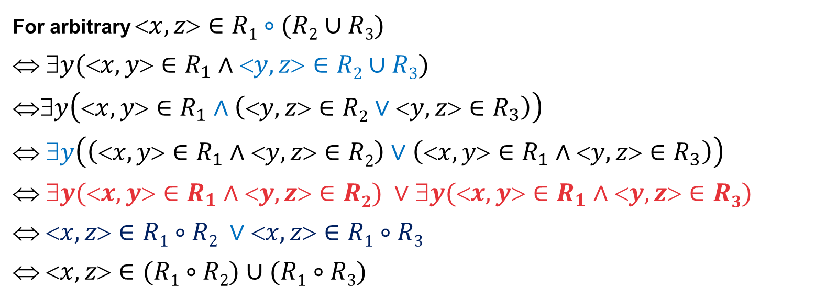
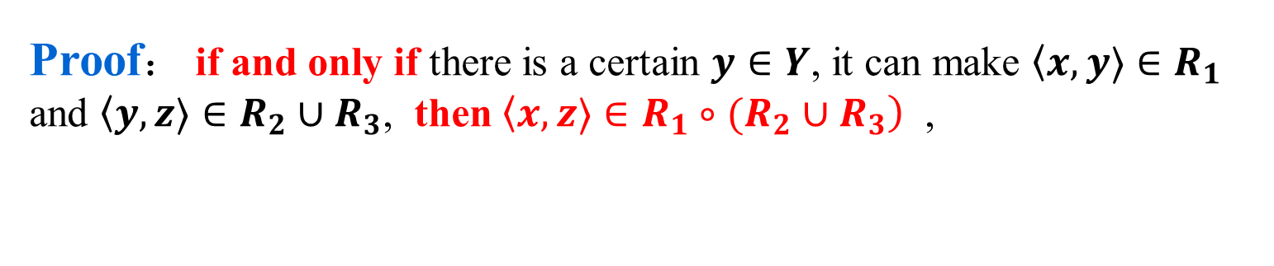
Relation operation
关系的性质
关系的表示
关系图
关系矩阵
关系的运算
合成
幂
逆
闭包
Proof： if and only if there is a certain $y∈Y$, it can make $〈x,y〉∈R_{1}$ and $〈y,z〉∈R_{2}∪R_{3}$, then $〈x,z〉∈R_{1}∘(R_{2}∪R_{3})$ ,
For arbitrary $x,z∈R1∘(R2∪R3)$
$$ y(x,y∈R_{1}∧y,z∈R2∪R3)$$
$$∃y\left(<x,y>∈R_{1}∧\left(<y,z>∈R2∨<y,z>∈R_{3}\right)\right)$$
$$ ∃y\left(\left(<x,y>∈R_{1}∧<y,z>∈R2\right)∨\left(<x,y>∈R_{1}∧<y,z>∈R_{3}\right)\right)$$
$$ y(x,y∈R_{1}∧y,z∈R2) ∨y(x,y∈R_{1}∧y,z∈R3)$$
$$ x,z∈R1∘R2 ∨x,z∈R1∘R3$$
$$ x,z∈(R1∘R2)∪(R1∘R3)$$
Notes:
存在量词对或是可以分配的。

Slide 23
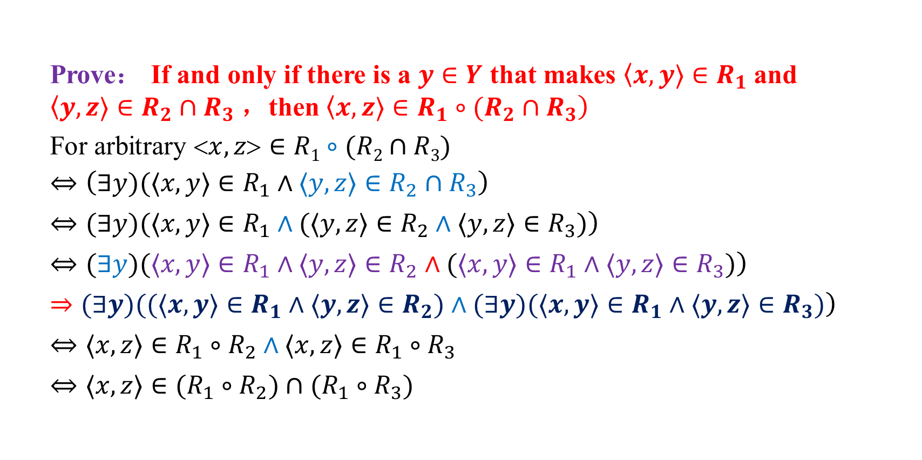
Relation operation
关系的性质
关系的表示
关系图
关系矩阵
关系的运算
合成
幂
逆
闭包
Prove： If and only if there is a $y∈Y$ that makes $〈x,y〉∈R_{1}$and $〈y,z〉∈R_{2}∩R_{3}$，then $〈x,z〉∈R_{1}∘(R_{2}∩R_{3})$
For arbitrary $x,z∈R1∘(R2∩R3)$
$$⇔\left(∃y)(〈x,y〉∈R_{1}∧〈y,z〉∈R_{2}∩R_{3}\right)$$
$$\left.⇔(∃y)(〈x,y〉∈R_{1}∧(〈y,z〉∈R_{2}∧〈y,z〉∈R_{3})\right)$$
$$\left.⇔(∃y)(〈x,y〉∈R_{1}∧〈y,z〉∈R_{2}∧(〈x,y〉∈R_{1}∧〈y,z〉∈R_{3})\right)$$
$$\left.⇒(∃y)((〈x,y〉∈R_{1}∧〈y,z〉∈R_{2})∧(∃y)(〈x,y〉∈R_{1}∧〈y,z〉∈R_{3})\right)$$
$$⇔〈x,z〉∈R_{1}∘R_{2}∧〈x,z〉∈R_{1}∘R_{3}$$
$$⇔〈x,z〉∈(R_{1}∘R_{2})∩(R_{1}∘R_{3})$$
Notes:
存在量词对于合取只满足蕴含式

Slide 24
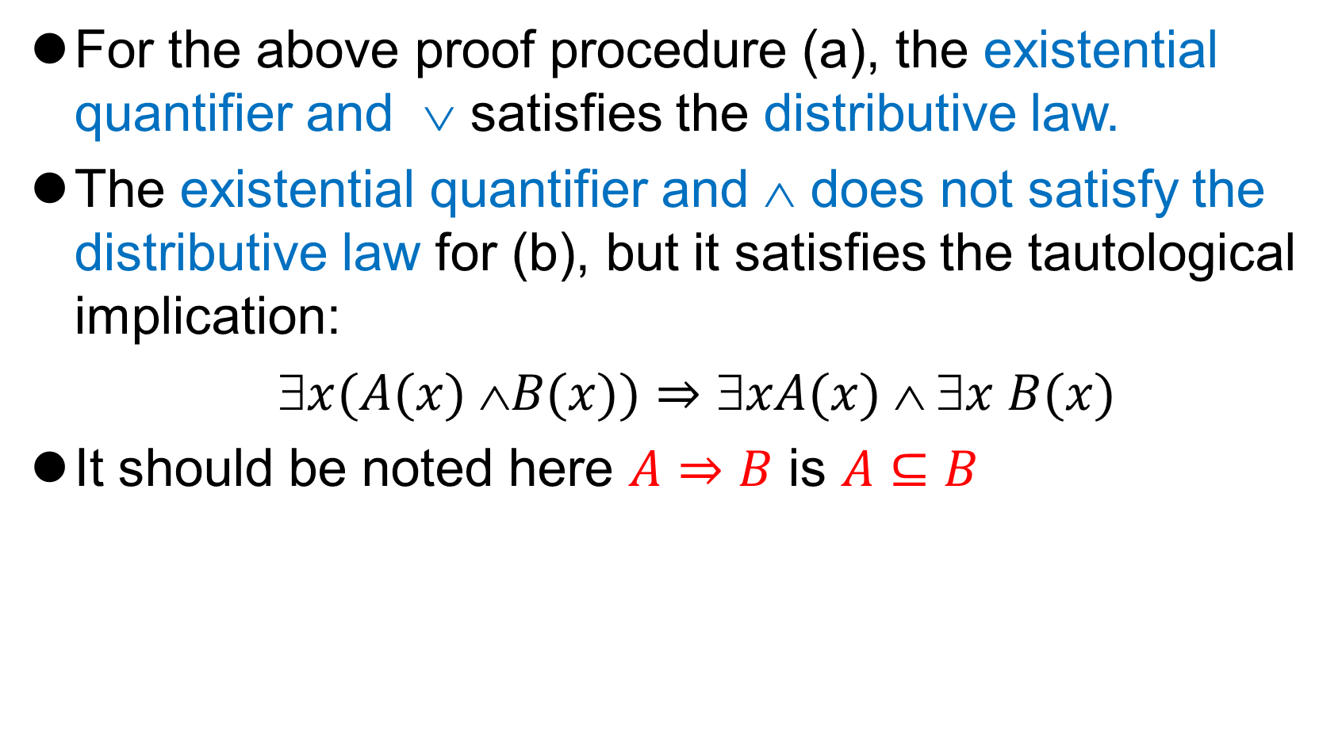
Relation operation
关系的性质
关系的表示
关系图
关系矩阵
关系的运算
合成
幂
逆
闭包
For the above proof procedure (a), the existential quantifier and ∨ satisfies the distributive law.
The existential quantifier and ∧ does not satisfy the distributive law for (b), but it satisfies the tautological implication:
$x(A(x) B(x))⇒xA(x)  x B(x)$
It should be noted here $A⇒B$ is $A⊆B$

Slide 25
Relation operation
关系的性质
关系的表示
关系图
关系矩阵
关系的运算
合成
幂
逆
闭包
The composite operation is a binary operation of a relation. By using this operation, a new relation can be generated from two relations, and the new relation can be combined to generate other relations.
Theorem: [Associative Laws] let R₁ be the relation from X to Y. R₂ is the relation from Y to Z. R₃ is the relation from Z to W. Thus

Slide 26
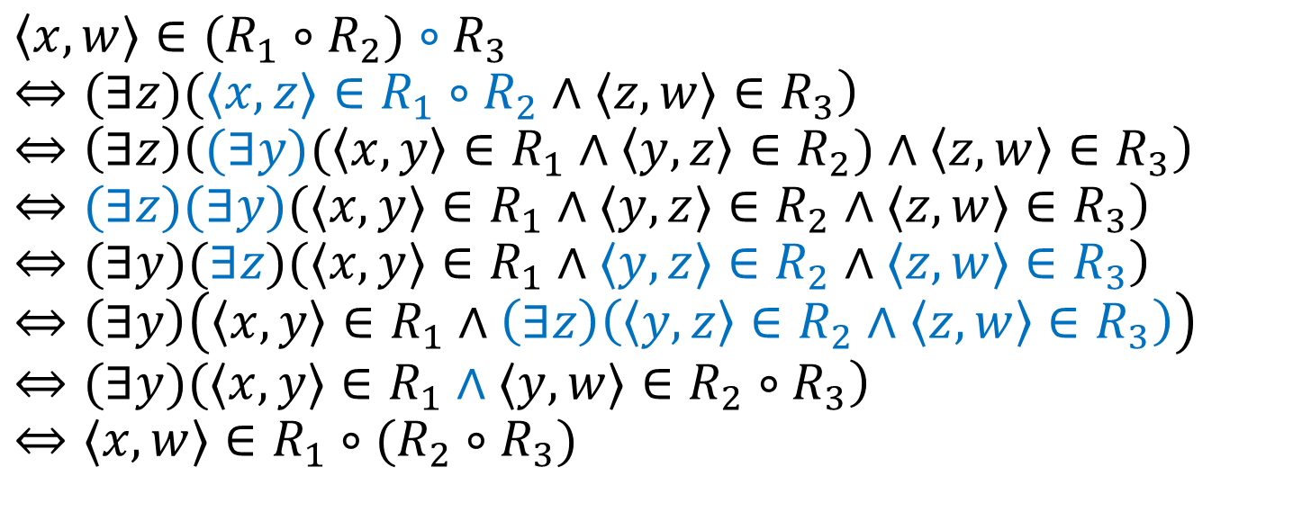
Relation operation
关系的性质
关系的表示
关系图
关系矩阵
关系的运算
合成
幂
逆
闭包
$$〈x,w〉∈(R_{1}∘R_{2})∘R_{3}$$
$$\left.⇔(∃z)(〈x,z〉∈R_{1}∘R_{2}∧〈z,w〉∈R_{3}\right)$$
$$⇔\left(∃z\right)\left((∃y)(〈x,y〉∈R_{1}∧〈y,z〉∈R_{2})∧〈z,w〉∈R_{3}\right)$$
$$\left.⇔(∃z)(∃y)(〈x,y〉∈R_{1}∧〈y,z〉∈R_{2}∧〈z,w〉∈R_{3}\right)$$
$$\left.⇔(∃y)(∃z)(〈x,y〉∈R_{1}∧〈y,z〉∈R_{2}∧〈z,w〉∈R_{3}\right)$$
$$⇔\left(∃y\right)\left(〈x,y〉∈R_{1}∧\left(∃z\right)\left(〈y,z〉∈R_{2}∧〈z,w〉∈R_{3}\right)\right)$$
$$\left.⇔(∃y)(〈x,y〉∈R_{1}∧〈y,w〉∈R_{2}∘R_{3}\right)$$
$$⇔〈x,w〉∈R_{1}∘(R_{2}∘R_{3}\text{)}$$

Slide 27
Relation operation
关系的性质
关系的表示
关系图
关系矩阵
关系的运算
合成
幂
逆
闭包
Example：Given relations R and S,
Then

Slide 28
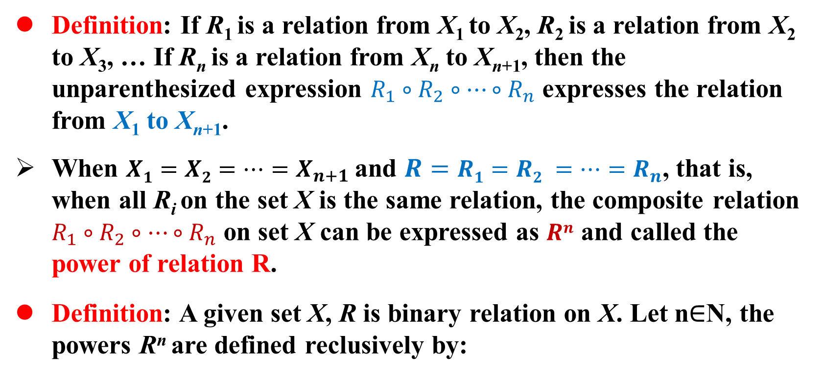
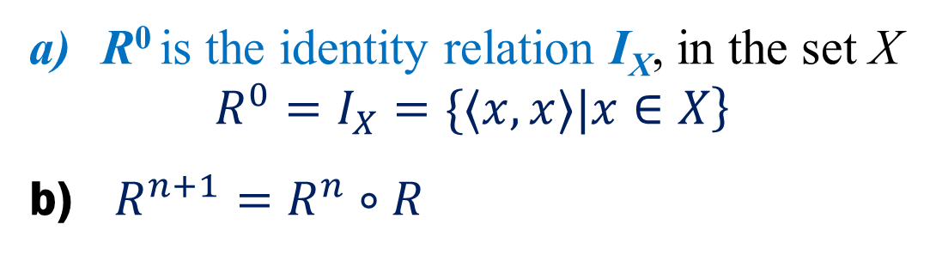
Powers of relation 关系的幂
关系的性质
关系的表示
关系图
关系矩阵
关系的运算
合成
幂
逆
闭包
Definition: If R₁ is a relation from X₁ to X₂, R₂ is a relation from X₂ to X₃, … If R_{n} is a relation from X_{n} to X_{n+1}, then the unparenthesized expression $R_{1}∘R_{2}∘⋯∘R_{n}$ expresses the relation from X₁ to X_{n+1}.
When $X1=X2=…=X_{n+1}$and $R=R1=R2 =…=R_{n}$, that is, when all R_{i} on the set X is the same relation, the composite relation $R_{1}∘R_{2}∘⋯∘R_{n}$ on set X can be expressed as $Rn$ and called the power of relation R.
Definition: A given set X, R is binary relation on X. Let n$∈$N, the powers R^{n} are defined reclusively by:
R⁰ is the identity relation I_{X}, in the set X
$$\left.R^{0}=I_{X}=\{〈x,x〉|x∈X\right\}$$
$R^{n+1}=R^{n}∘R$

Slide 29
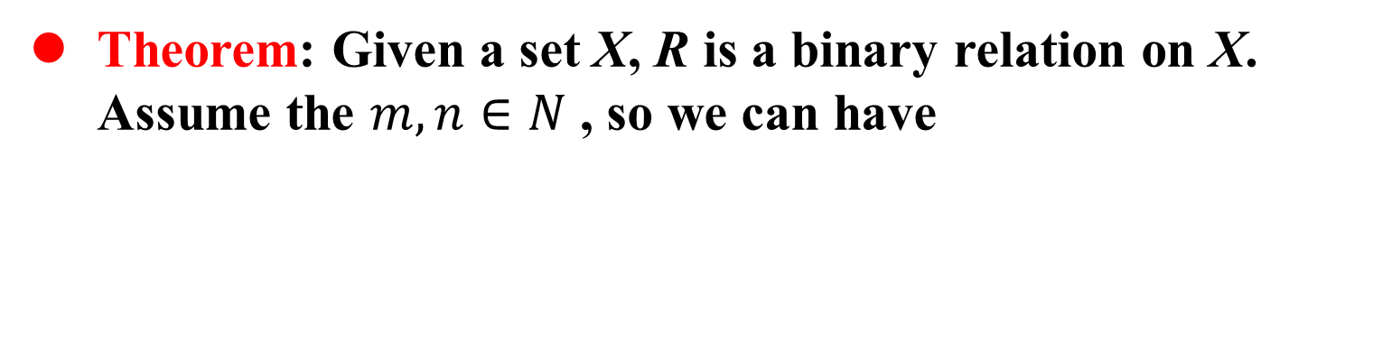
Powers of relation
关系的性质
关系的表示
关系图
关系矩阵
关系的运算
合成
幂
逆
闭包
Theorem: Given a set X, R is a binary relation on X. Assume the $m,n∈N$ , so we can have
Example：Let X={a,b,c}，R₁,R₂,R₃,R₄ are the relations on X, and
Give the powers of these relations

Slide 30
Powers of relation
关系的性质
关系的表示
关系图
关系矩阵
关系的运算
合成
幂
逆
闭包
Solution：

Slide 31
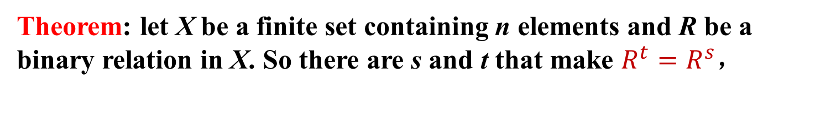
Powers of relation
关系的性质
关系的表示
关系图
关系矩阵
关系的运算
合成
幂
逆
闭包
Theorem: Let A be a finite set, and |A| = n, R is the binary relation on A, then we have
Notes:
这个证明不好，可以借鉴电子科大的。

Slide 32
Matrix and Digraph of Composite Relations
关系的性质
关系的表示
关系图
关系矩阵
关系的运算
合成
幂
逆
闭包
Example：Give set X={0,1,2,3}，R is the relation on X，and
Draw the relation digraph of and
0
0
0
3
1
3
1
3
1
2
2
2
(a)
(
b
)
(
c
)
Notes:
多了一个<3,1>，那下一次这个再合成R的时候是空集，所以与R3一样了，

Slide 33
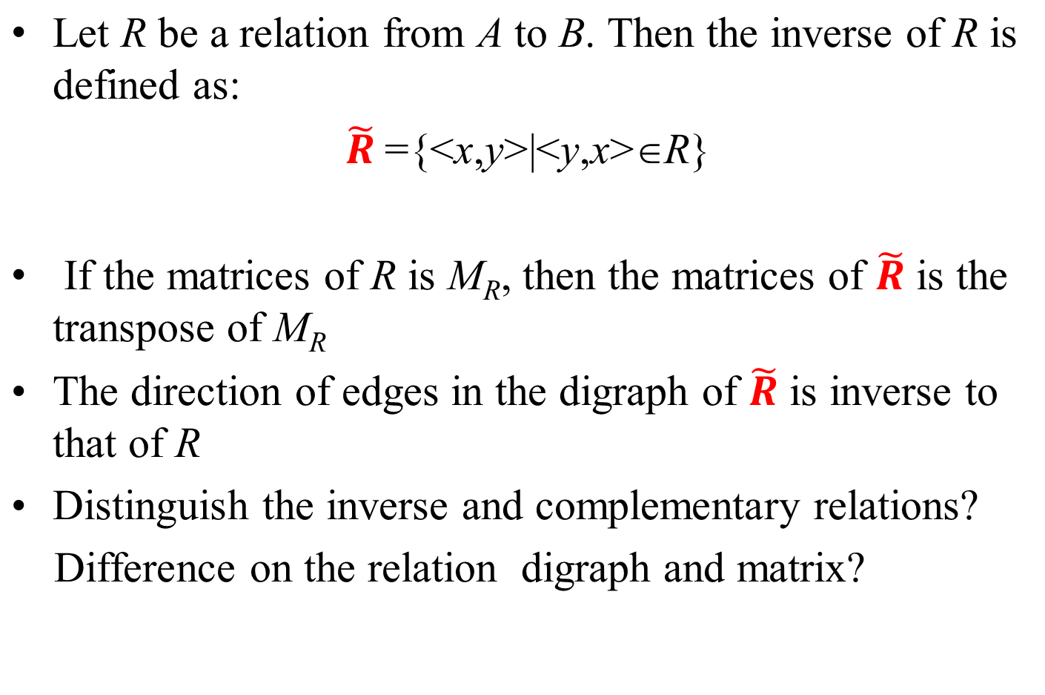
Inverse (逆) operation of relation
关系的性质
关系的表示
关系图
关系矩阵
关系的运算
合成
幂
逆
闭包
Notes:
关系矩阵的转置

Slide 34
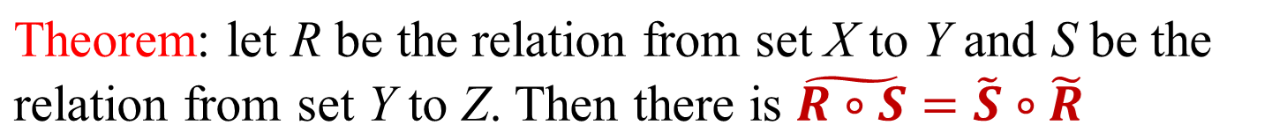
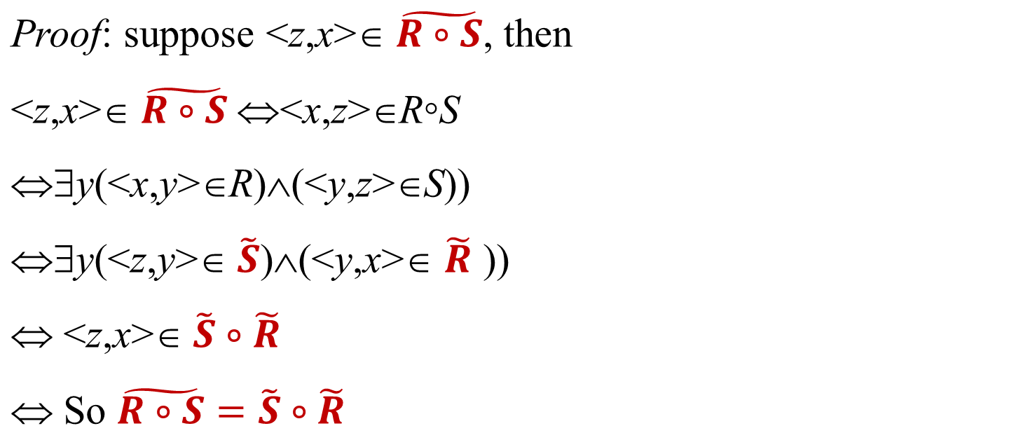
The inverse Operation of composition relation
关系的性质
关系的表示
关系图
关系矩阵
关系的运算
合成
幂
逆
闭包
It can also be understood by using relation matrices

Slide 35
The inverse Operation of composition relation
关系的性质
关系的表示
关系图
关系矩阵
关系的运算
合成
幂
逆
闭包
Example：Give the relation matrices M_{R} and M_{S}
Then ：

Slide 36
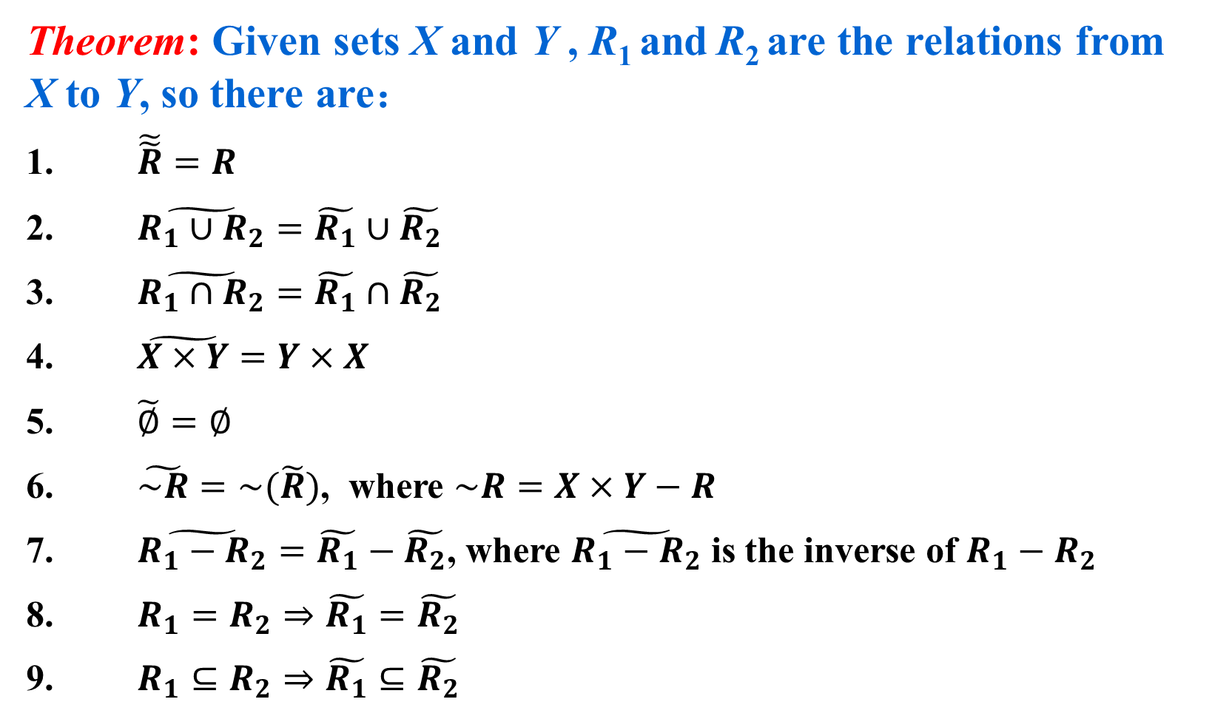
Inverse operation of relation
关系的性质
关系的表示
关系图
关系矩阵
关系的运算
合成
幂
逆
闭包
Theorem: Given sets X and Y , R₁ and R₂ are the relations from X to Y, so there are：
$\tilde{\tilde{R}}=R$
$\tilde{R_{1}∪R_{2}}=\tilde{R_{1}}∪\tilde{R_{2}}$
$\tilde{R_{1}∩R_{2}}=\tilde{R_{1}}∩\tilde{R_{2}}$
$\tilde{X×Y}=Y×X$
$\tilde{∅}=∅$
$\tilde{\sim R}=\sim (\tilde{R})$, where $\sim R=X×Y−R$
$\tilde{R_{1}−R_{2}}=\tilde{R_{1}}−\tilde{R_{2}}$, where $\tilde{R_{1}−R_{2}}$ is the inverse of $R_{1}−R_{2}$
$R_{1}=R_{2}⇒\tilde{R_{1}}=\tilde{R_{2}}$
$R_{1}⊆R_{2}⇒\tilde{R_{1}}⊆\tilde{R_{2}}$

Slide 37
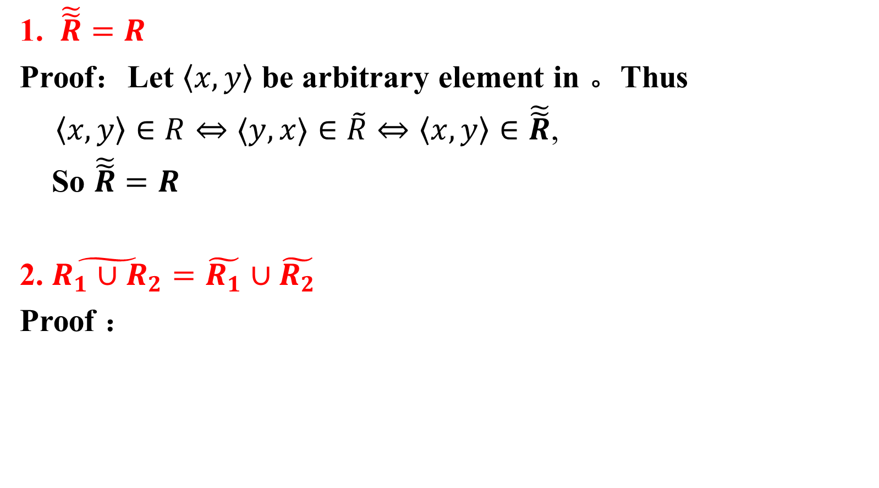
Inverse operation of relation
关系的性质
关系的表示
关系图
关系矩阵
关系的运算
合成
幂
逆
闭包
1. $\tilde{\tilde{R}}=R$
Proof：Let $〈x,y〉$ be arbitrary element in 。Thus
$\left\langle x,y\right\rangle ∈R⇔〈y,x〉∈\tilde{R}⇔\left\langle x,y\right\rangle ∈\tilde{\tilde{R}}$,
So $\tilde{\tilde{R}}=R$
2. $\tilde{R_{1}∪R_{2}}=\tilde{R_{1}}∪\tilde{R_{2}}$
Proof ：

Slide 38
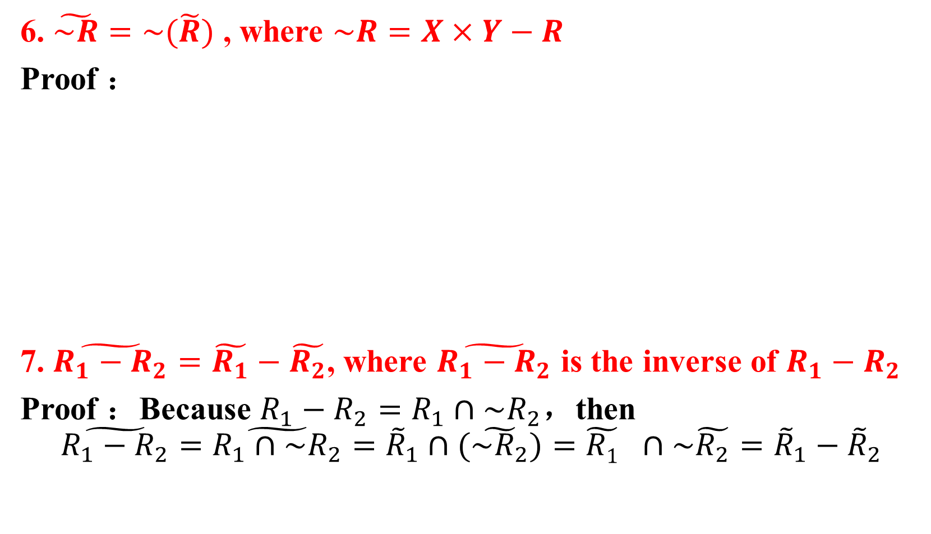
Inverse operation of relation
关系的性质
关系的表示
关系图
关系矩阵
关系的运算
合成
幂
逆
闭包
6. $\tilde{\sim R}=\sim (\tilde{R})$ , where $\sim R=X×Y−R$
Proof ：
7. $\tilde{R_{1}−R_{2}}=\tilde{R_{1}}−\tilde{R_{2}}$, where $\tilde{R_{1}−R_{2}}$ is the inverse of $R_{1}−R_{2}$
Proof ：Because $R_{1}−R_{2}=R_{1}∩\sim R_{2}$，then
$$\tilde{R_{1}−R_{2}}=\tilde{R_{1}∩\sim R_{2}}={\tilde{R}}_{1}∩(\tilde{{\sim R}_{2}}){=\tilde{R1}}_{}∩\sim \tilde{R_{2}}={\tilde{R}}_{1}−{\tilde{R}}_{2}$$

Slide 39
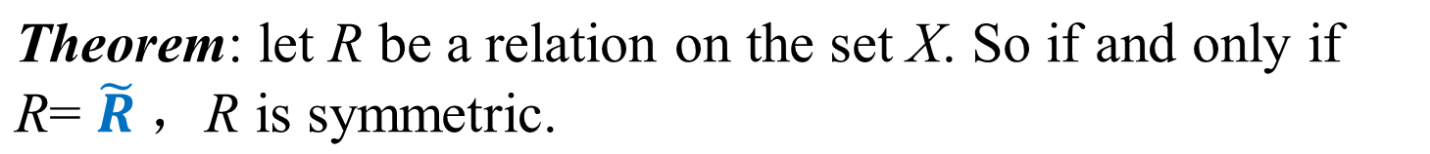
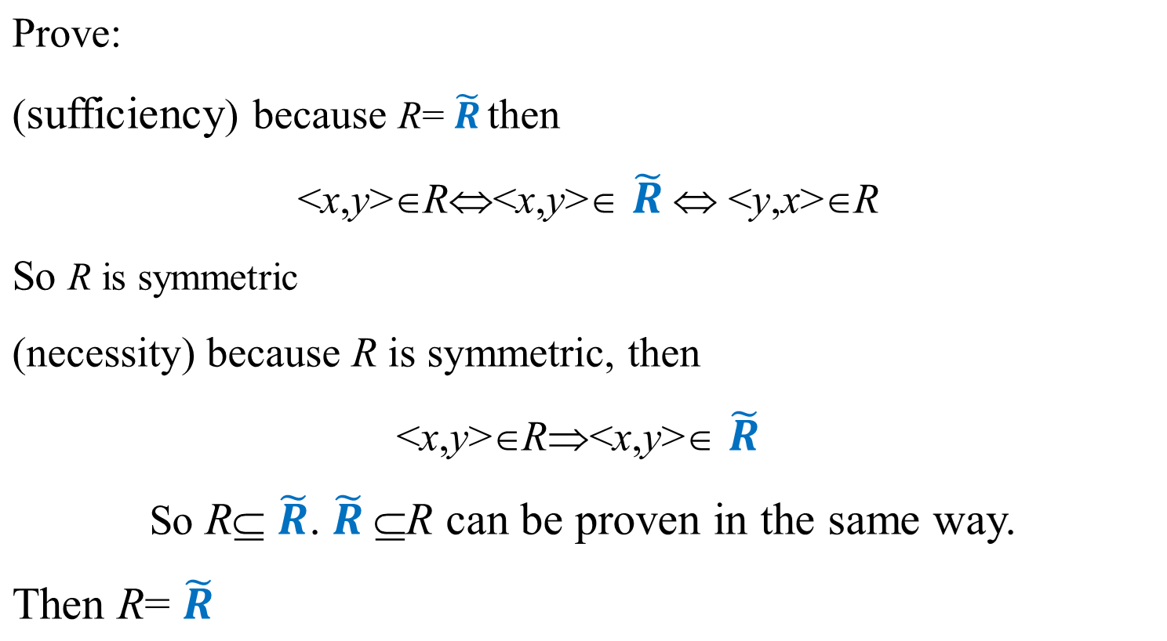
Inverse operation of relation
关系的性质
关系的表示
关系图
关系矩阵
关系的运算
合成
幂
逆
闭包

Slide 40
Closures (闭包) of relations
关系的性质
关系的表示
关系图
关系矩阵
关系的运算
合成
幂
逆
闭包
Definition : given set X, R is a binary relation on X. If another relation R′ satisfies
（1） R′ is reflexive (symmetric, transitive)；
（2） R′⊇R
（3） For any reflexive (symmetric, transitive) relation R″，if
R″⊇R，then R″⊇R′
then R′ is called the reflexive (symmetric, transitive) closure of R.
The reflexive closure（自反闭包） of R is represented by r(R),
the symmetric closure（对称闭包） of R is represented by s(R),
the transitive closure（可传递闭包） of R is represented by t(R).

Slide 41
Closures (闭包) of relations
关系的性质
关系的表示
关系图
关系矩阵
关系的运算
合成
幂
逆
闭包
How to understand the definition？
R
R′
R′′
1
1
1
3
3
3
2
2
2
R ⊆ R′
R ⊆ R′′
R′ ⊆ R′′

Slide 42
Closures operation of relations
关系的性质
关系的表示
关系图
关系矩阵
关系的运算
合成
幂
逆
闭包
Theorem: given set X, R is a relation on X. Then there are:
(a) if and only if r(R)=R, R is reflexive.
(b) if and only if s(R)=R, R is symmetric.
(c) if and only if t(R)=R, R is the transitive.

Slide 43
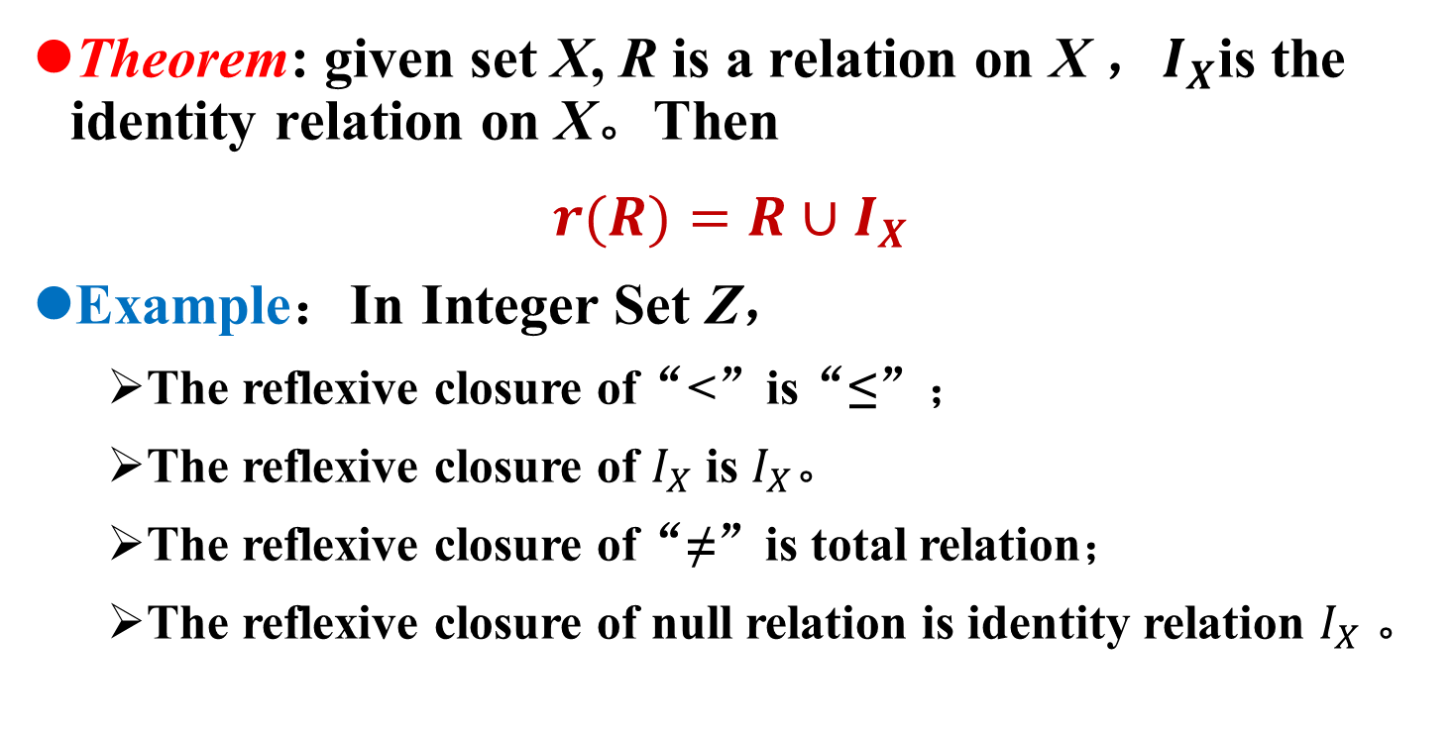
Closures operation of relations
关系的性质
关系的表示
关系图
关系矩阵
关系的运算
合成
幂
逆
闭包
Theorem: given set X, R is a relation on X ，$I_{X}$is the identity relation on X。Then
$r(R)=R∪I_{X}$
Example：In Integer Set Z，
The reflexive closure of“<”is“≤”；
The reflexive closure of $I_{X}$ is $I_{X}$。
The reflexive closure of“≠”is total relation；
The reflexive closure of null relation is identity relation $I_{X}$ 。

Slide 44
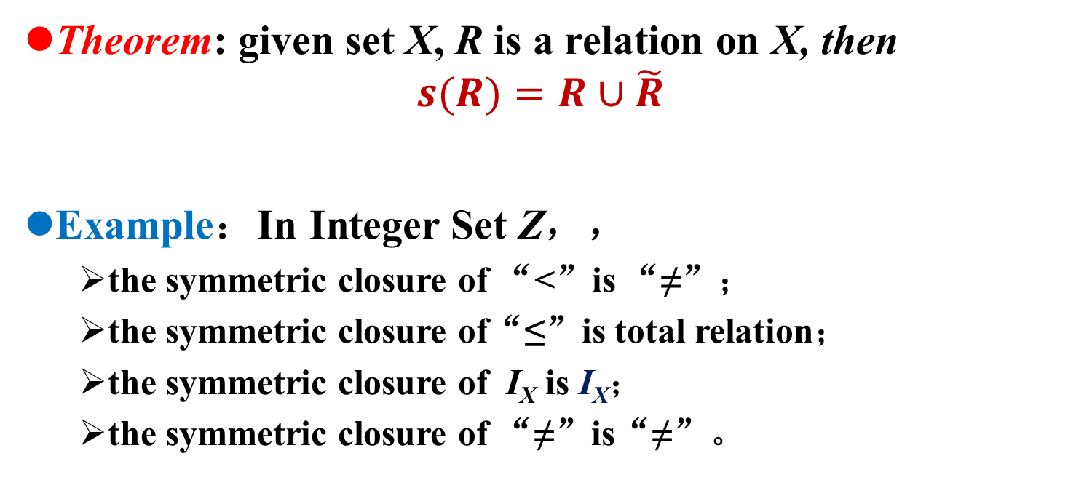
Closures operation of relations
关系的性质
关系的表示
关系图
关系矩阵
关系的运算
合成
幂
逆
闭包
Theorem: given set X, R is a relation on X, then
$$s(R)=R∪\tilde{R}$$
Example：In Integer Set Z，，
the symmetric closure of “<”is “≠”；
the symmetric closure of“≤”is total relation；
the symmetric closure of I_{X} is I_{X}；
the symmetric closure of “≠”is“≠”。

Slide 45
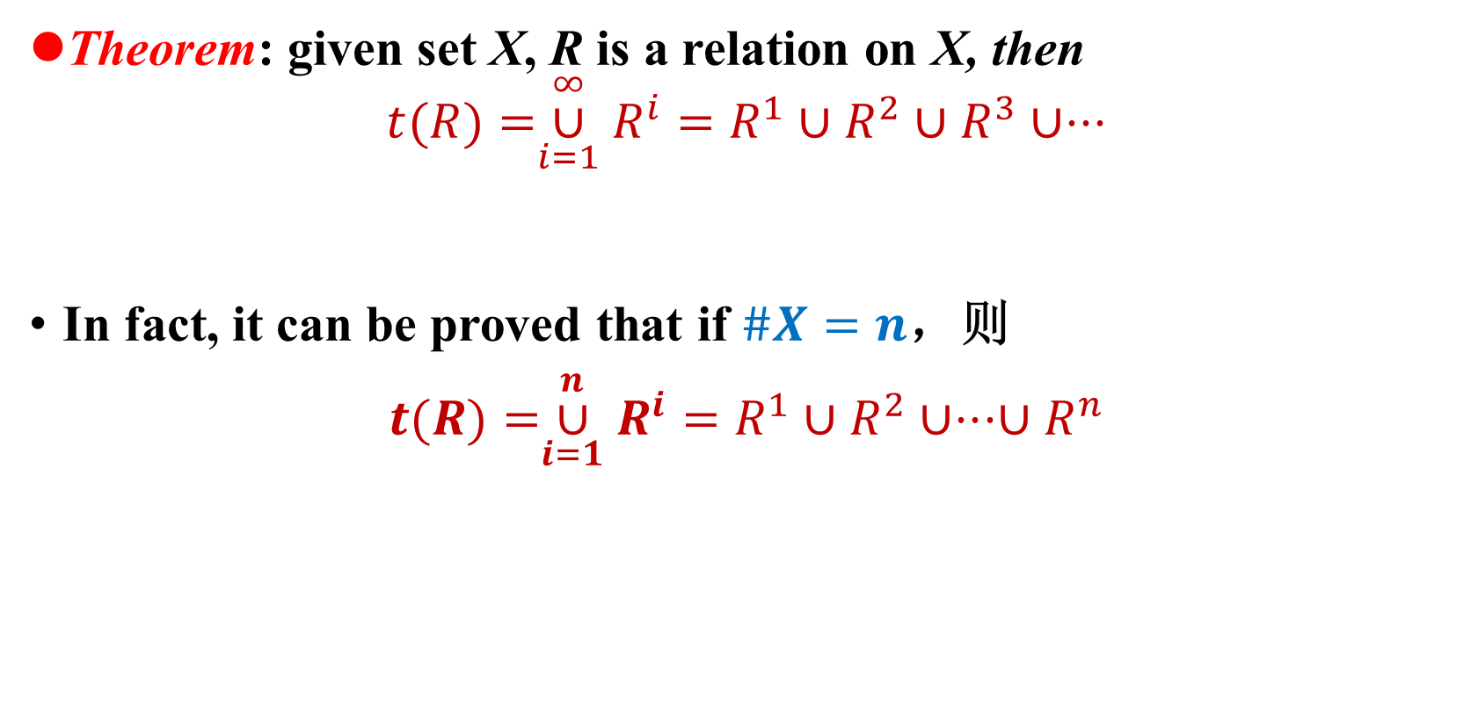
Closures operation of relations
关系的性质
关系的表示
关系图
关系矩阵
关系的运算
合成
幂
逆
闭包
Theorem: given set X, R is a relation on X, then
$$t(R)=\overset{∞}{\underset{i=1}{∪}}R^{i}=R^{1}∪R^{2}∪R^{3}∪⋅⋅⋅$$
In fact, it can be proved that if $\#X=n$，则
$t(R)=\overset{n}{\underset{i=1}{∪}}R^{i}=$ $R^{1}∪R^{2}∪⋅⋅⋅{∪R}^{n}$

Slide 46
Closures operation of relations
关系的性质
关系的表示
关系图
关系矩阵
关系的运算
合成
幂
逆
闭包
Example：Let set X={a,b,c}, R and S are the relations on X，if
Try to find out t(R),t(S), and draw the digraphs of the relations.
Solution：
R,t(R)
S
t(S)

Slide 47
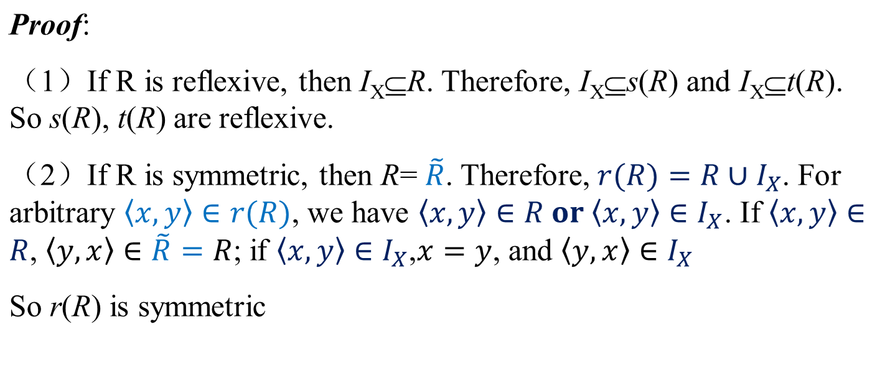
Closures operation of relations
关系的性质
关系的表示
关系图
关系矩阵
关系的运算
合成
幂
逆
闭包
Theorem: let X be a set, R is a relation on X, so there is
（1）If R is reflexive, then s(R), t(R) are reflexive；
（2）If R is symmetric, then r(R), t(R) are symmetric；
（3）If R is transitive, then r(R) is transitive.

Slide 48
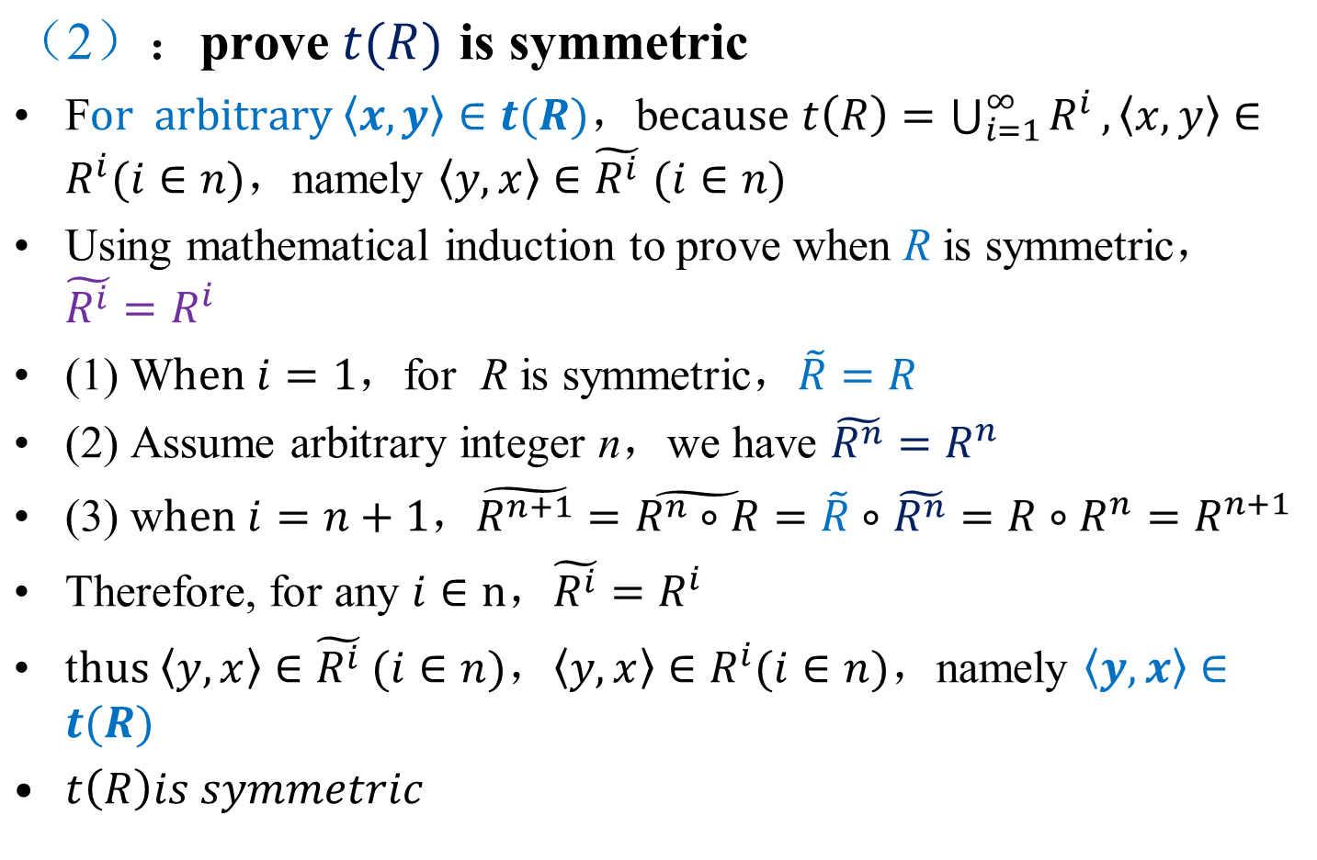
Closures operation of relations
关系的性质
关系的表示
关系图
关系矩阵
关系的运算
合成
幂
逆
闭包

Slide 49
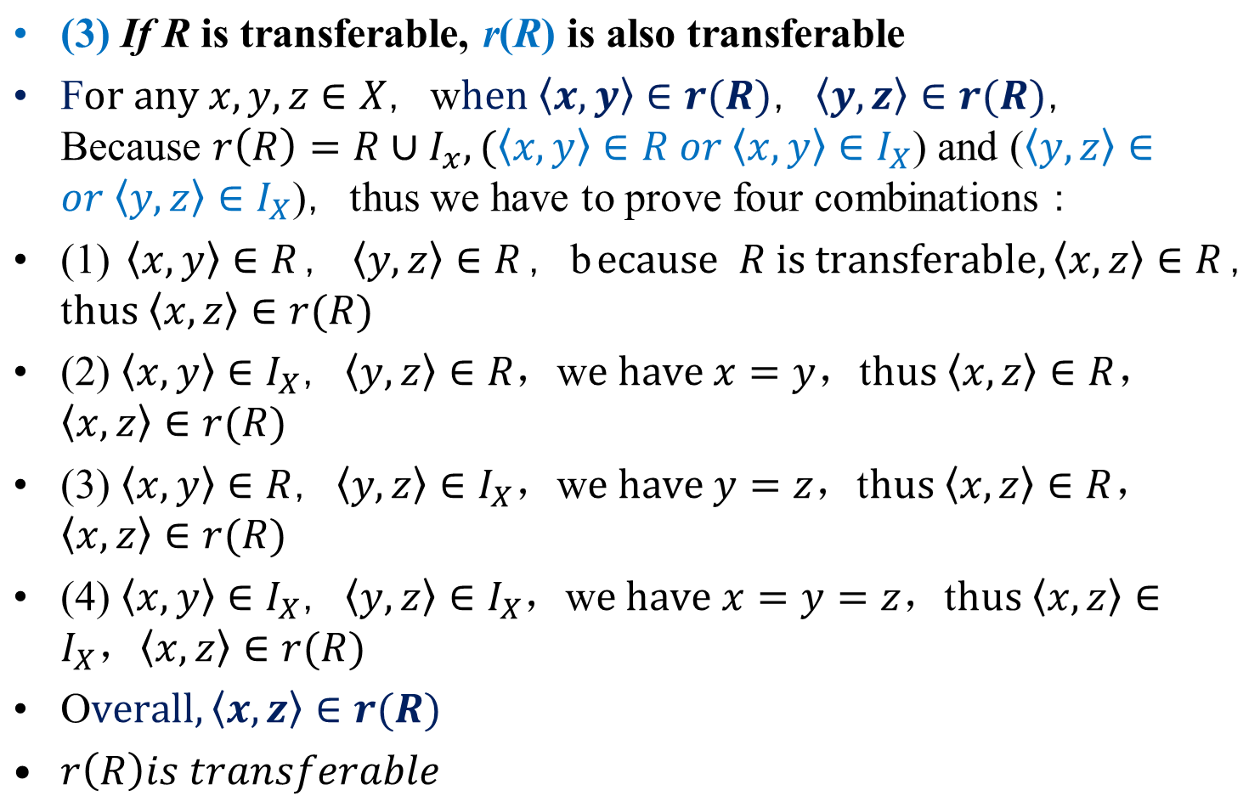
Closures operation of relations
关系的性质
关系的表示
关系图
关系矩阵
关系的运算
合成
幂
逆
闭包

Slide 50
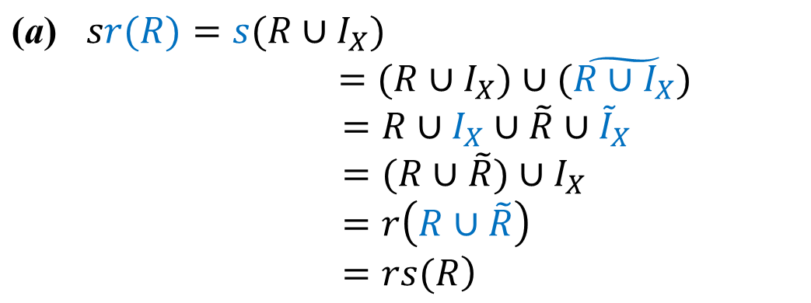
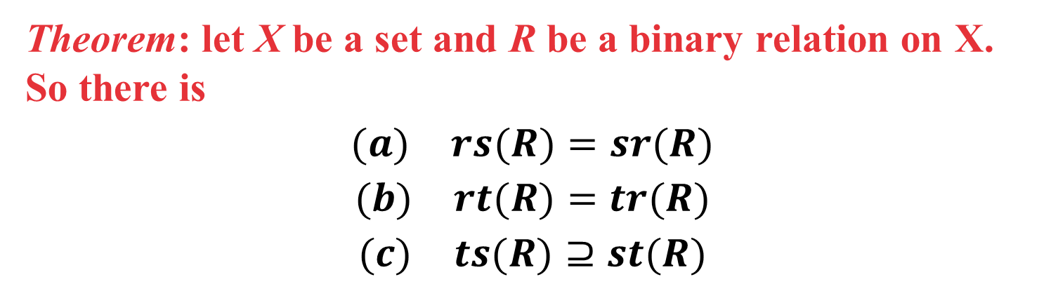
Closures operation of relations
关系的性质
关系的表示
关系图
关系矩阵
关系的运算
合成
幂
逆
闭包
Theorem: let X be a set and R be a binary relation on X. So there is
$$(a) rs(R)=sr(R)$$
$$(b) rt(R)=tr(R)$$
$$(c) ts(R)⊇st(R)$$
Proof：

Slide 51
Closures operation of relations
关系的性质
关系的表示
关系图
关系矩阵
关系的运算
合成
幂
逆
闭包
Proof:（b）because
therefore

Slide 52

Closures operation of relations
关系的性质
关系的表示
关系图
关系矩阵
关系的运算
合成
幂
逆
闭包
$$(c) ts(R)⊇st(R)$$
Proof:（c）if R₁⊇R₂ ，then s(R₁)⊇s(R₂) and t(R₁)⊇t(R₂).
s(R)⊇R, so ts(R)⊇t(R) and sts(R)⊇st(R).
s(R) is symmetric, so ts(R) is also symmetric and sts(R)=ts(R).
ts(R)⊇st(R)
1
3
Definition:
（1） R⁺=t(R)
（2） R*=tr(R)
2

Slide 53
Homework
P103：11,13,15,17,19

Slide 54

The End
Thanks

